Slide 1

California Housing Prices
Applied Machine Learning with Python

Slide 2

Agenda
Dataset
EDA
Feature Engineering
Model Implementation
Hyperparameter Tuning
Model Evaluation

Slide 3
Dataset
Problem Type
Regression
Target Variable
Median House Value
Source
Kaggle

Slide 4
Dataset
Features:
Longitude
Latitude
Housing median age
Total rooms
Total bedrooms
Population
Households
Median income
Ocean proximity
Shape before cleaning:
20640 x 10
Shape after cleaning:
17994 x 11

Slide 5
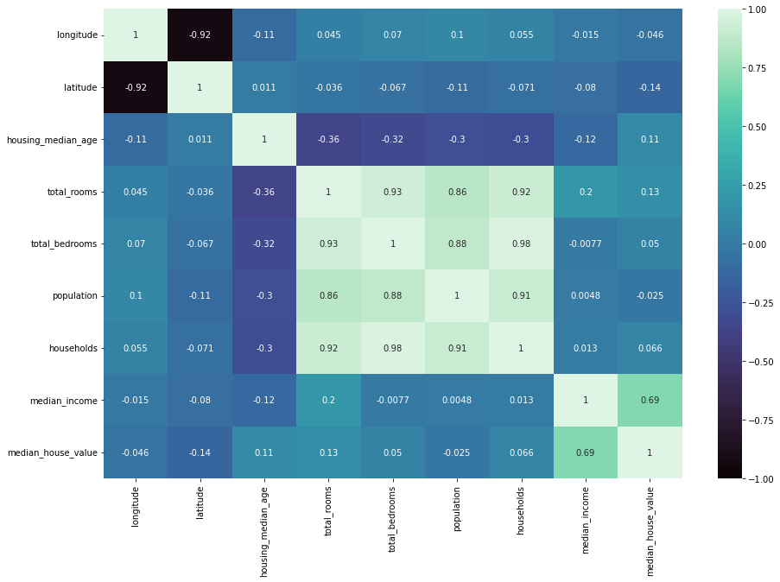
Exploratory data analysis
Correlation:
Median house value and median income are highly correlated

Slide 6
Exploratory data analysis
Dataset had imbalanced distributions, to fix it we used ‘Lumping’
Before
After

Slide 7
OLS model

Slide 8
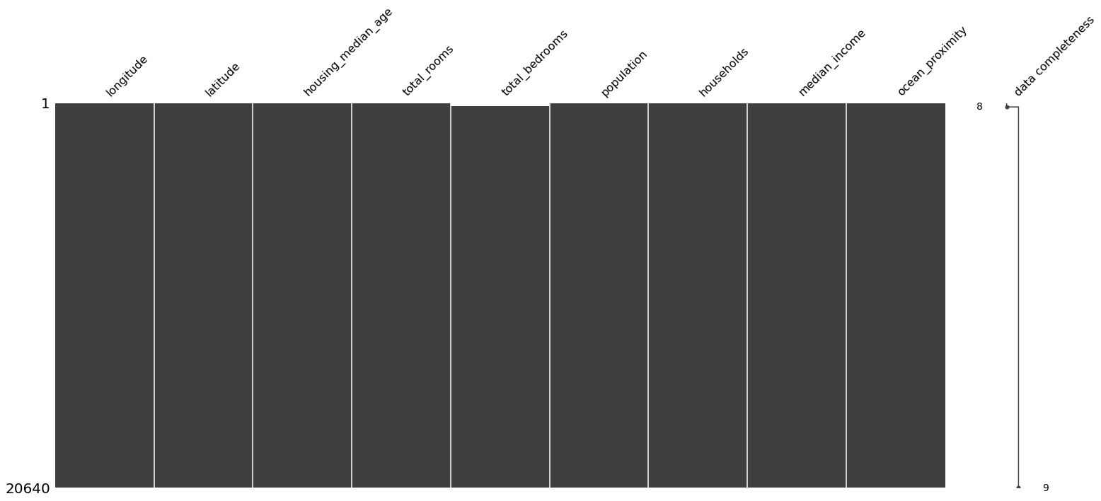
Missingness
Dataset had 207 missing values, after further investigation we found that the values were missing at random

Slide 9
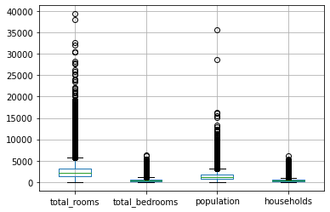
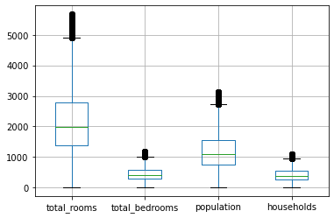
Extreme values
After outlier removal
Before outlier removal

Slide 10
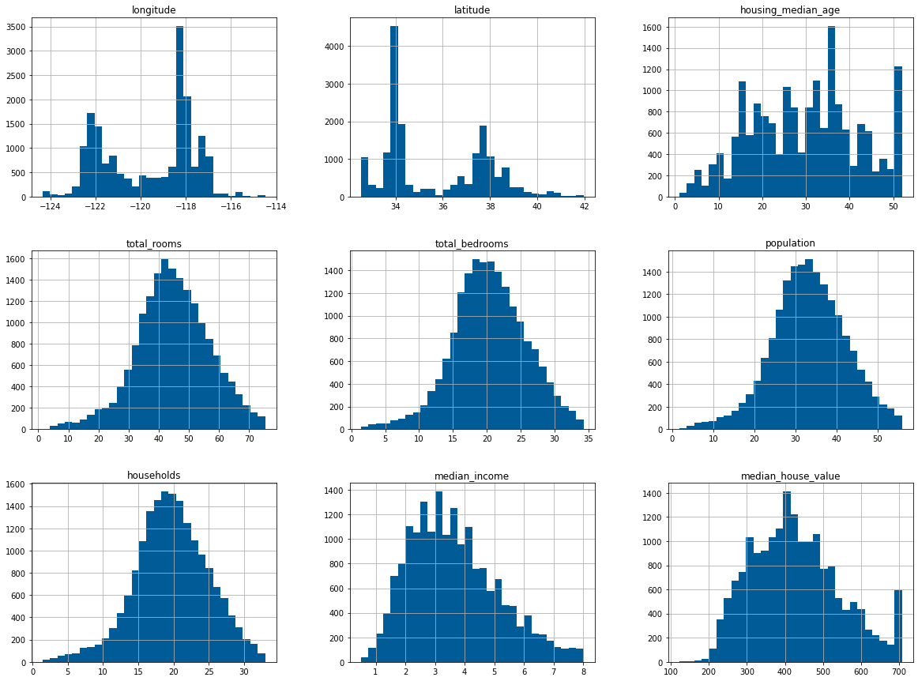
Skewness
While exploring the dataset we found that 5 different features had a right skewed distribution, below are the distributions after performing a square root transformation

Slide 11
OLS model

Slide 12
Redundant features
Features
Latitude
Housing_median_age
Total_rooms
Median_income
Median_house_value
Ocean_proximity_INLAND
To spot redundant features we used two tests
1. ANOVA

Slide 13
Redundant features
Features
Longitude
Latitude
Housing_median_age
Median_income
Median_house_value
Ocean_proximity_INLAND
To spot redundant features we used two tests
2. Mutual Information

Slide 14
Model Implementation

Slide 15
Data Prep
Splitting the data
70:30
Encoding categorical data
One hot encoding

Slide 16
XGBRegressor
Trained and fit the model with default hyperparameters
Got RMSE of 49.0087
Performed random search and got the following best parameters:
{'n_estimator': 3, 'max_depth': 7, 'eta': 0.1}
Used best parameters
Got RMSE of 325.9228
Performed grid search and got the same parameters

Slide 17
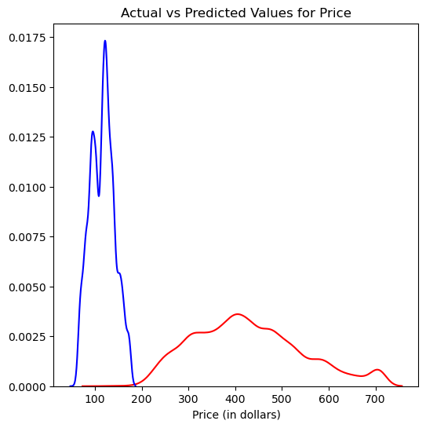
XGBRegressor

Slide 18
Random Forest Regressor
Trained and fit the model with default hyperparameters
Got RMSE of 50.3976
Performed random search and got the following best parameters:
{'n_estimators’: 100, 'min_samples_split': 5, 'min_samples_leaf': 2, 'max_features': ‘sqrt', 'max_depth’: 30, 'bootstrap’: False}
Used random search best parameters
Got RMSE of 66.0274
Performed grid search and got the following parameters
{'bootstrap’: False, 'max_depth’: 30, 'max_features': ‘sqrt', 'min_samples_leaf’: 1, 'min_samples_split’: 2, 'n_estimators': 100}
Used grid search best parameters
Got RMSE of 65.2006

Slide 19
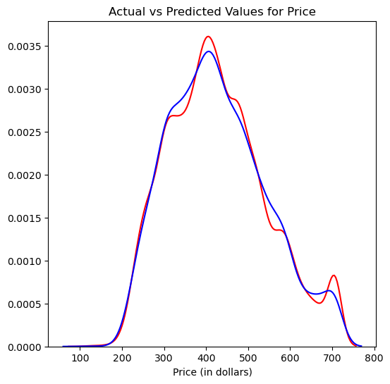
RFR with Grid Search

Slide 20
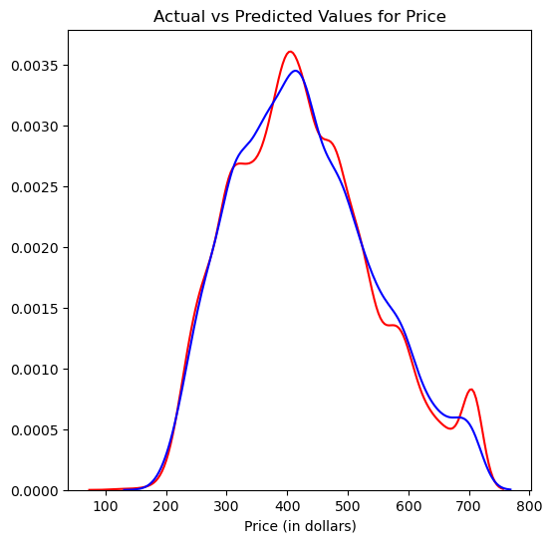
RFR with Random Search

Slide 21
Conclusion
Random forest regressor performed better than XGBRegressor on this dataset
Trying out different encoding methods could produce better results
Using a different scale could also improve the results

